Slide 1

A Project on Retail Superstore

Slide 2
Contents
Introduction
Data Source
Data Cleaning
Creating a Data Base
Visualizing Reports and telling Stories using tableau
Using Linear Regression Model to Estimate Sales for the Future

Slide 3
1. Introduction
This project is about a retail store which has branches in various countries. The products are primarily furniture's, office supplies and appliances. The customers are broadly classified into three main categories i.e individuals, home office and corporate.
The data set available contains four years sales, quantities, shipping cost and profit.
The main objective of the project is to forecast sales and profit for the future based on last four years data using supervised machine learning, linear regression model to be more specific.

Slide 4
2. Data Source
We have used Kaggle.com to retrieve data set for the project.
Data set contains 24 columns and around 52K rows in flat file(csv).
The data points contains four years of sales and profit information which can be used to plot regression line and use supervised machine learning to create a model.
The machine learning model created can give the sales and profit forecast for the future period (y axis) when we put year and month in the X axis ( independent variable)

Slide 5
3. Data Cleaning
We will start with data cleaning activity by importing csv file to Jupyter notebook.
The data cleaning mainly entails, dropping columns with null values, inserting columns to have year and month information, converting date columns to datetime format, getting total value of the discount etc.
The analysis of data set to understand distribution of sales over various customer segment, products and countries.
Unearth any hidden relationship between sales, profit , products, discount and customer segments.
Following assumptions made on the data set
Sales is gross sales
Profit is gross profit before discount and shipping cost

Slide 6
3.1 Data Cleaning in action
We have done the following to clean the data set and added few new columns relevant for the analysis; We have used Jupyter notebook to perform EDA
Converted shipping and order date types to datetime
Added a new column to get month year data from shipping date
Converted discount column to percentage and created a new column to get the amount of discount for each rows wherever discount rate is there.
We have assumed sales column as gross sales and inserted a column to get the unit sale price for each raw
We have added a column to get the unit cost price before discount and shipping charges, the unit cost price is derived by ( sales minus gross profit) divided by units sold.
We have dropped column containing postal code as most of the rows are blank
After cleaning the data, we have saved the data frame as sales.csv

Slide 7
4. Creating a Data Base
After cleaning the data set, we will create a data base in Pg Admin .
A ERD diagram will be created to showing relationship between tables.
We will be creating , address table, product table,order ID table and category table.
After creating a tables, we will run a query to generate various reports like top 10 profitable products, top performing countries, profitability of shipping method vis a vis order priority etc.

Slide 8
4.1 Creating a Data Base in action
We have created ERD for the data base and created following tables in PG admin
Sales table- with order ID as primary key
country table with order ID as primary key
Category table
Year and month table
Discount and profit table
Below is the screen shot of the table created in PG Admin

Slide 9
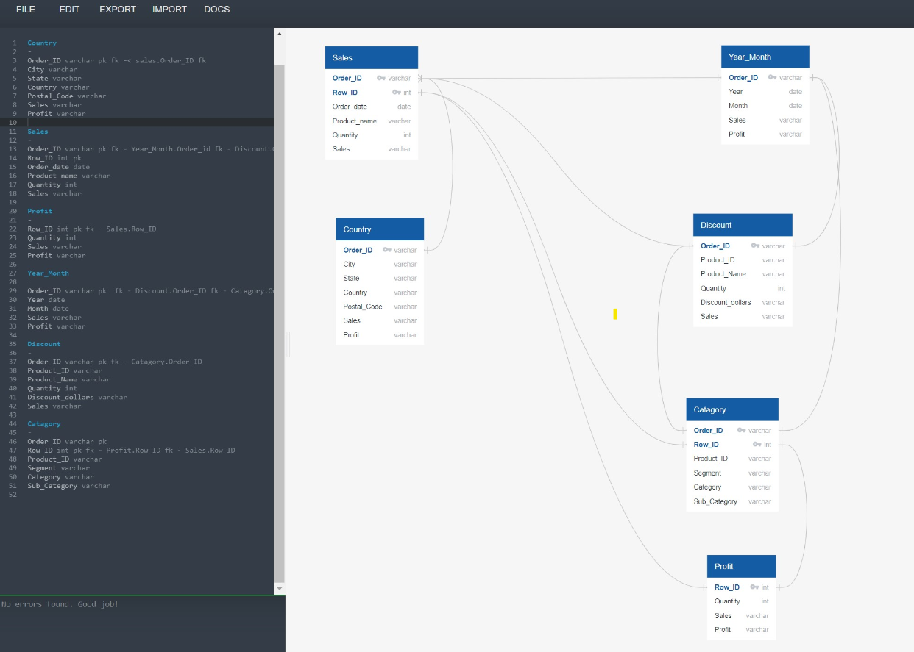
4.1 Creating a Data Base in action

Slide 10
5. Visualizing Reports and Telling Stories Using Tableau
The reports created in SQL (Pg Admin) will be used to visualize information in Tableau.
Based on various reports visualized, we will create a story, explaining facts about the superstore i.e displaying revenue growth over time, customer profit analysis, distribution of revenue over various geographical locations.
Visualize sales over time to display trend to understand which months of the year we have higher sales and which months are characterized as slow sales. This will help to plan stocking of inventories to ensure we are not overstocking inventories when sales are slow and not understocking when sales are more during specific month of the year.
We will present various what if scenario’s to explain what will be the profit if we change shipping mode, sales with and without discount etc.

Slide 11
5.1 Visualizing Reports and Telling Stories Using Tableau – in action
We have created following dashboard to visualize performance of the store
Distribution of sales over various geographical area displaying in a world map
Ship mode vs order priority
Yearly sales of the main and subcategory
Sales per segment to know which segment is the highest contributor to total sales
Profit by market
Profit by category

Slide 12
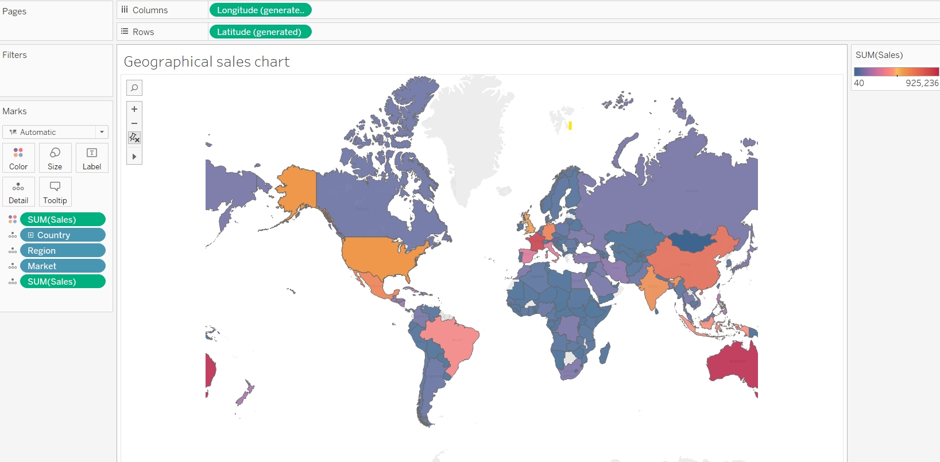
5.1 Visualizing Reports and Telling Stories Using Tableau – in action
Sales distribution over various geographical area

Slide 13
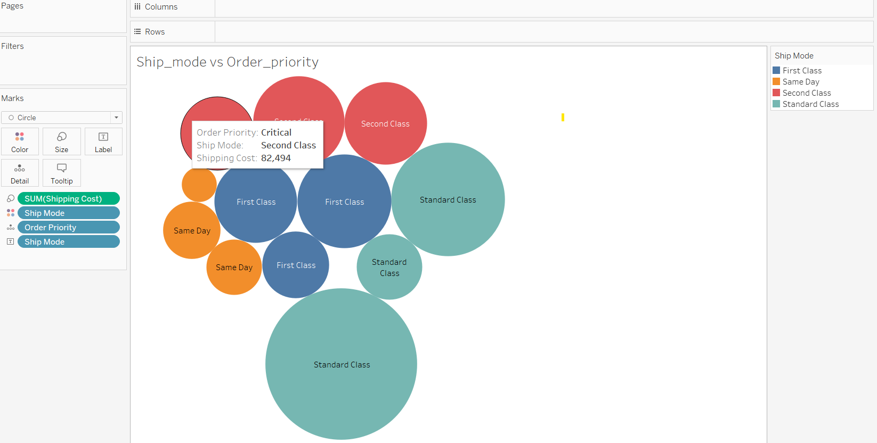
5.1 Visualizing Reports and Telling Stories Using Tableau – in action
Ship mode vs order priority

Slide 14
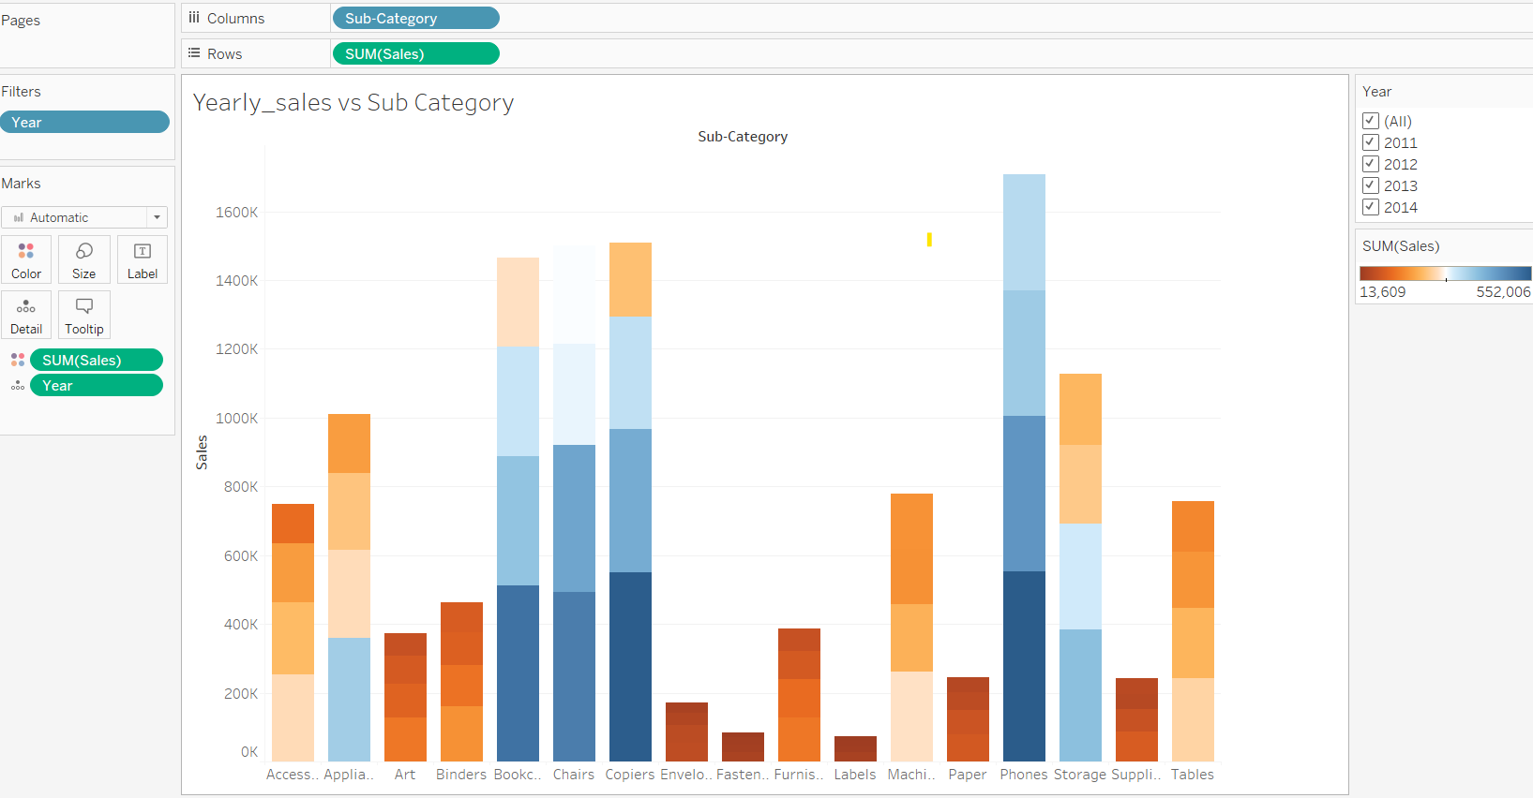
5.1 Visualizing Reports and Telling Stories Using Tableau – in action
Yearly sales of the main and subcategory

Slide 15
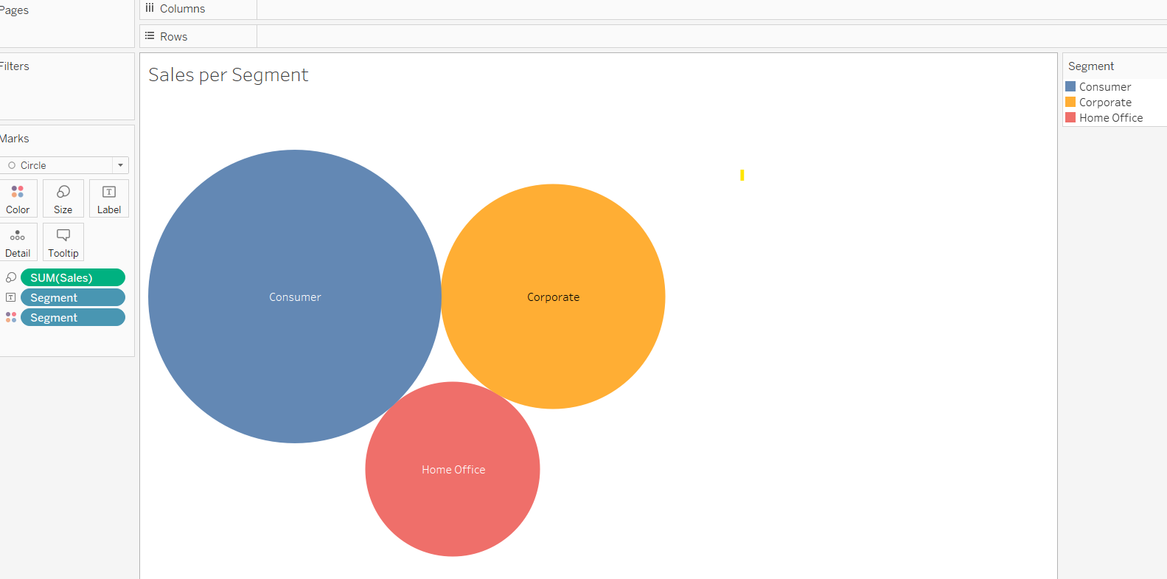
5.1 Visualizing Reports and Telling Stories Using Tableau – in action
Sale as per customer segment

Slide 16
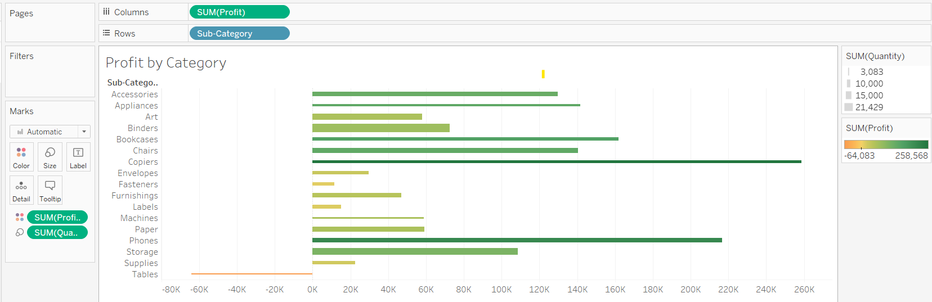
5.1 Visualizing Reports and Telling Stories Using Tableau – in action
Profit by category

Slide 17
6. Using machine learning Model to Estimate Sales for the Future
After we get a clean data set and understanding in depth the business trend, we will move on to predict sales forecast for the future.
Since data’s available for this project are continuous and have labels, we will use supervised learning model to predict sales for the future.
The most suitable model for this type of data set will be liner regression model. We will initiate a liner regression model to plot sales(y axis) over time(X axis) and get a line of best fit . We will implement our knowledge of liner regression from the weather forecast module where we tried to predict weather forecast.
After we create a liner regression model, we will use scikit-learn tool to train and test the model and get the accuracy and F score of the mode.
After we satisfy with the machine learning model, we will plot year and month in X axis to predict sales for the future. We will try this model to predict sales for each of the three customer segment separately.

Slide 18
6.1 Using machine learning Model to Estimate Sales for the Future- In action
We have chosen US as country to initiate machine learning to forecast sales, profit and volume using various machine learning models
The choice made to select US due to the fact that it was around 10K rows and sales and profit is substantially higher than other countries
We have tried following machine learning models to select model which provide maximum accuracy.
Multiclass classification model
Multiple regression model and
Random forest model

Slide 19
Conclusion
This presentation serve a frame work for the project and guide team members to follow steps in order to achieve the milestones.
We will insert slides after we achieve each milestone to display outcome of the exercise.
………………………………….nothing follows------------------------------------------

